Slide 1

NIRO · Next Intelligent Resource Optimizer
AI Assistant:
The Smart Work Companion
A unified intelligence platform for H&R Block Offshore Operations.
Smart · Trustworthy · Modern · Efficient · Wow
✦
Cog in the engine
NIRO connects people, processes, systems, training resources and performance views without replacing existing workflows.
✨ Pitch-ready management concept
NIRO Pitch • 1/10
Notes:
[Sources]
Visual on this slide was generated with Microsoft Copilot.
Content is based on user-provided NIRO concept and slide outline.

Slide 2
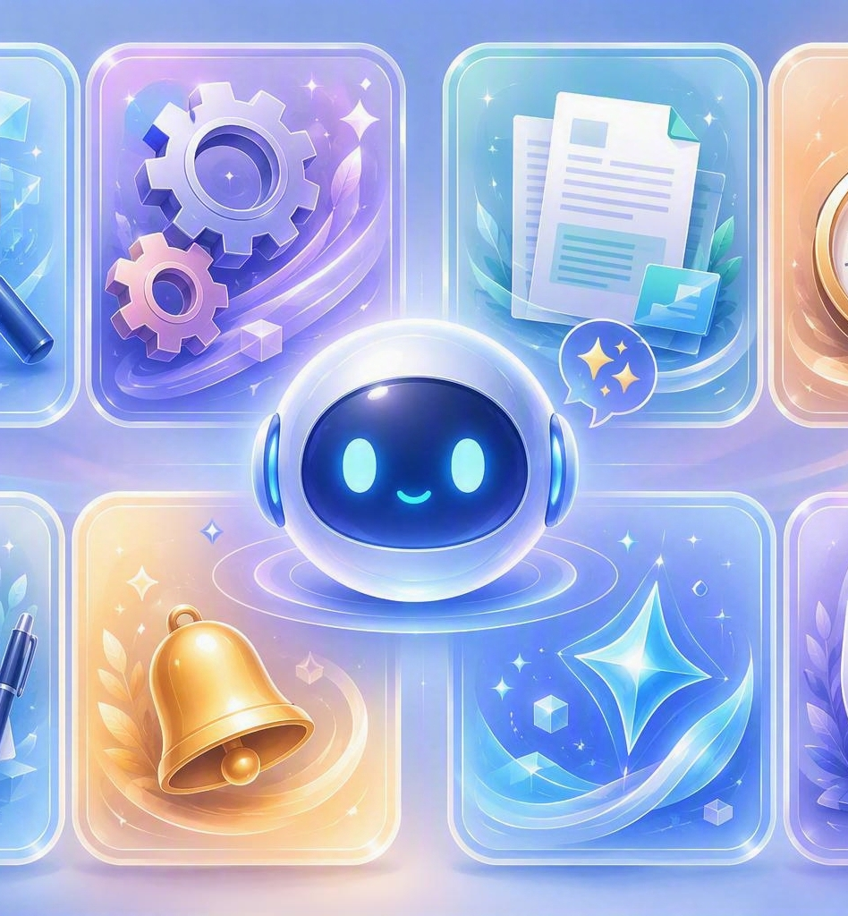
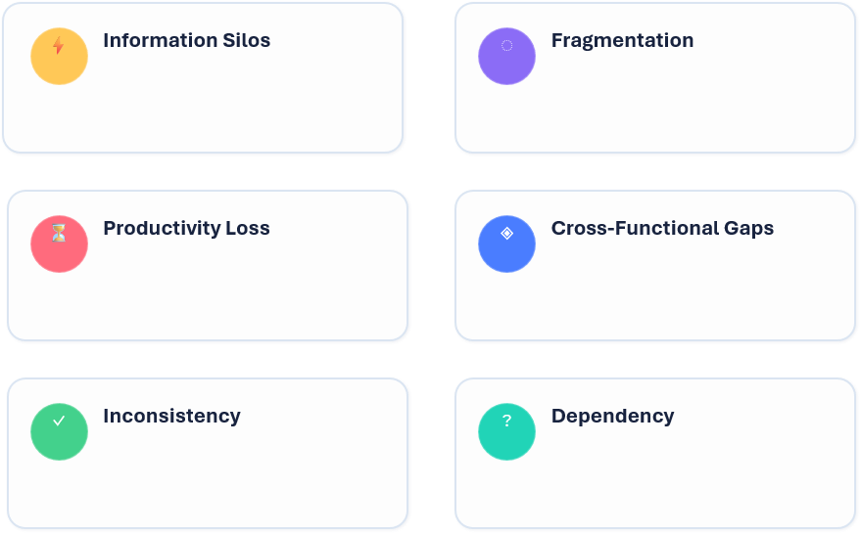
The Problem: Work Is Slower Than It Should Be
Current friction points
!
!
!
Result: teams spend energy chasing work instead of completing work.
NIRO Pitch • 2/10
Notes:
[Sources]
Visual on this slide was generated with Microsoft Copilot.
Content is based on user-provided NIRO concept and slide outline.

Slide 3
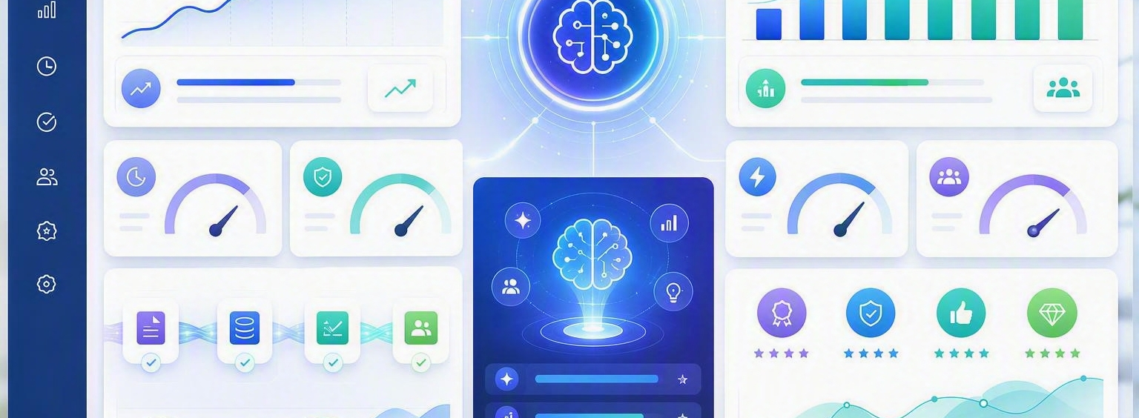
AI Trusted Intelligence Layer
NIRO integration model
Employees / Teams
→
AI Trusted Layer
→
ERP · HR · Finance · Ops
→
Knowledge
→
Faster Outputs
NIRO Pitch • 3/10
Notes:
[Sources]
Visual on this slide was generated with Microsoft Copilot.
Content is based on user-provided NIRO concept and slide outline.

Slide 4

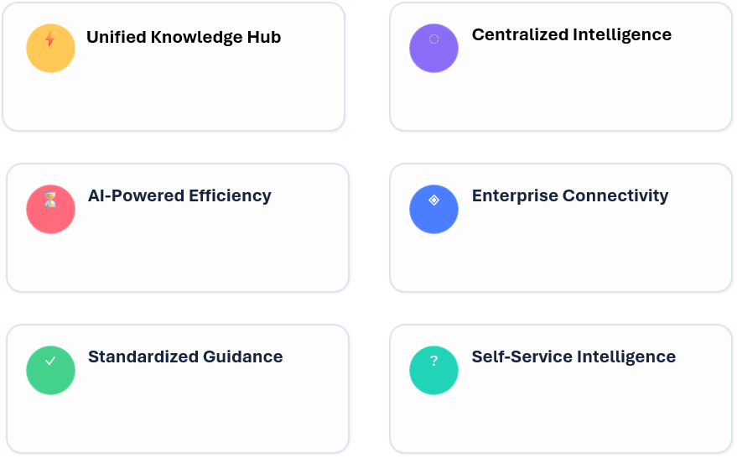
The Solution: One AI Assistant for Smarter Work
Reliable digital teammate
⚙
▥
↗
NIRO Pitch • 4/10
Notes:
[Sources]
Visual on this slide was generated with Microsoft Copilot.
Content is based on user-provided NIRO concept and slide outline.

Slide 5

From Manual Chaos to Smart Flow
Before vs After
BEFORE ⚠️
AFTER ✅
Slow searching · Manual updates · Repeated questions
Instant answers · Faster decisions · Better accuracy
NIRO Pitch • 6/10
Notes:
[Sources]
Visual on this slide was generated with Microsoft Copilot.
Content is based on user-provided NIRO concept and slide outline.

Slide 6
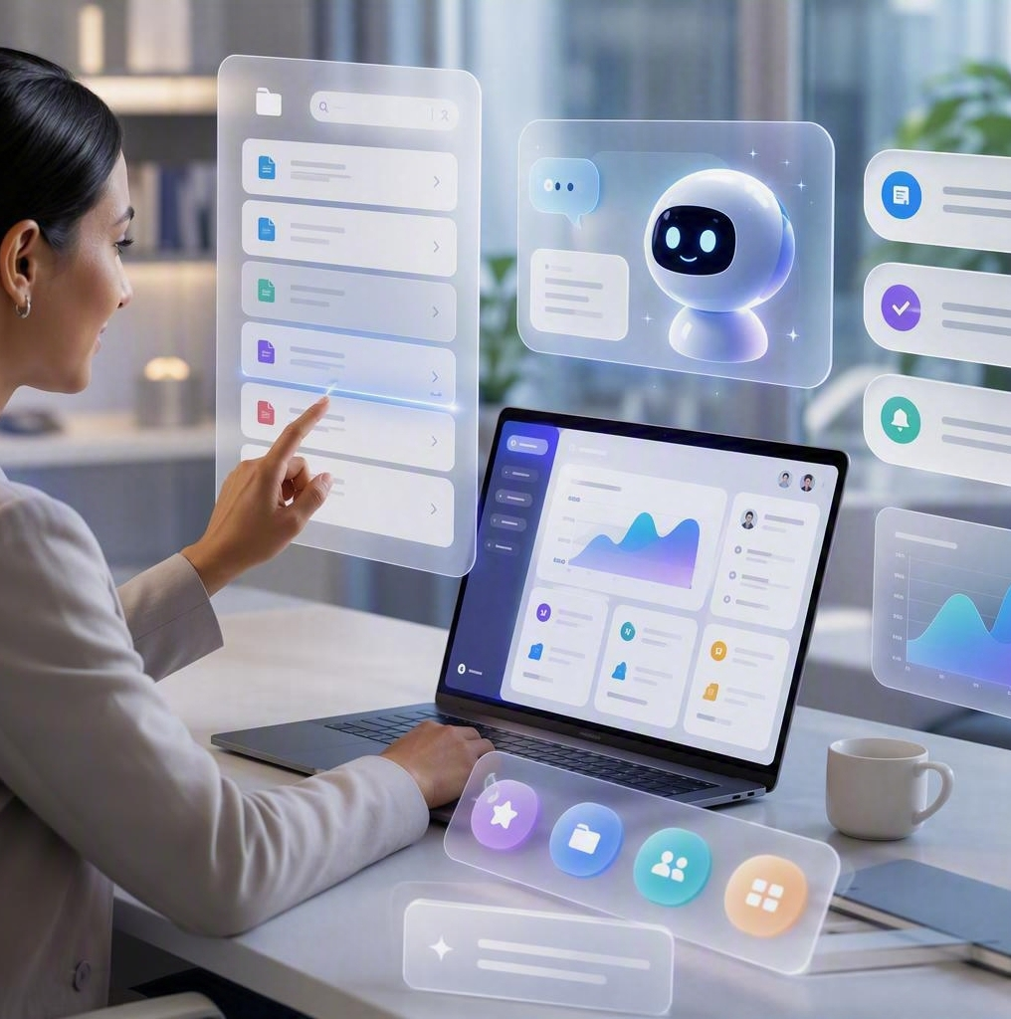
Impact That Management Will Care About
Measurable operating value
⏱
Saves employee time
↗
Improves productivity
Less searching, faster work
More output from same capacity
🔗
Reduces dependency
▣
Standardizes knowledge
Clear answers at the point of work
Same process guidance for all teams
✓
Improves accuracy
◆
Scales growth
Quality checkpoints and risk alerts
Reusable intelligence across departments
NIRO Pitch • 7/10
Notes:
[Sources]
Visual on this slide was generated with Microsoft Copilot.
Content is based on user-provided NIRO concept and slide outline.

Slide 7
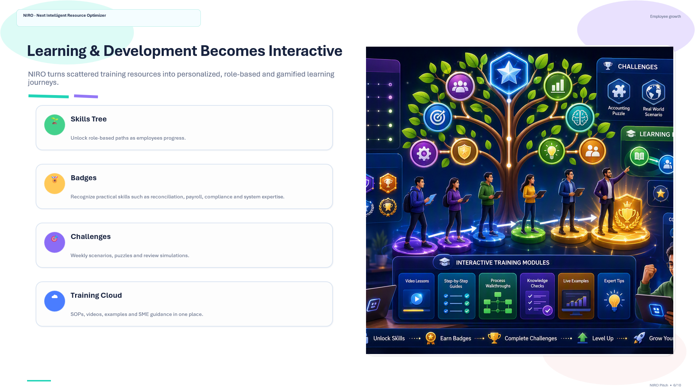

Slide 8
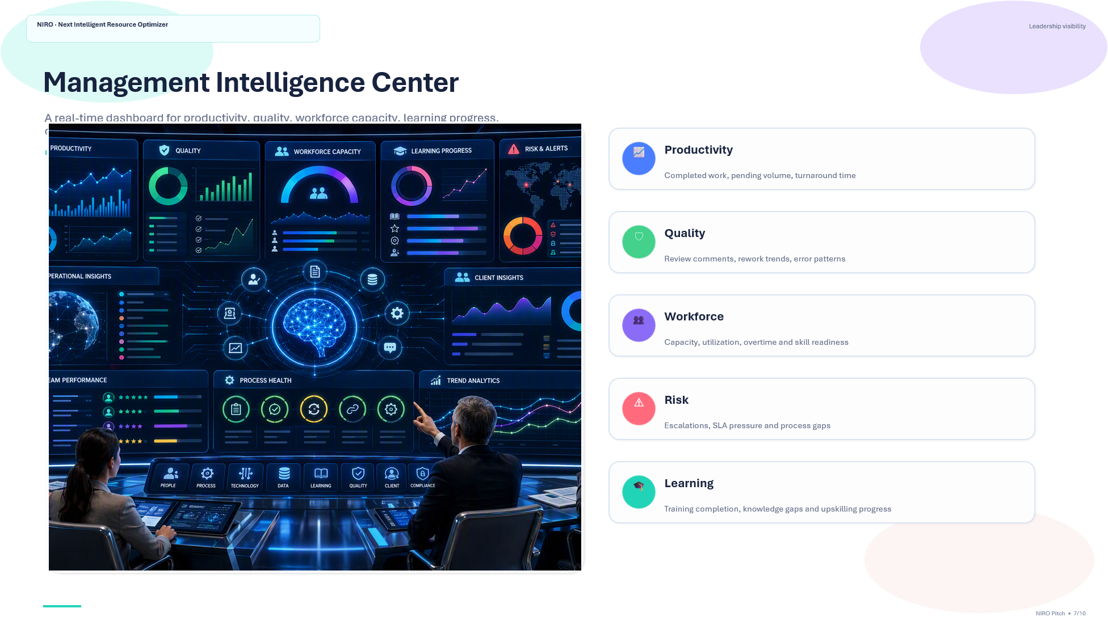

Slide 9
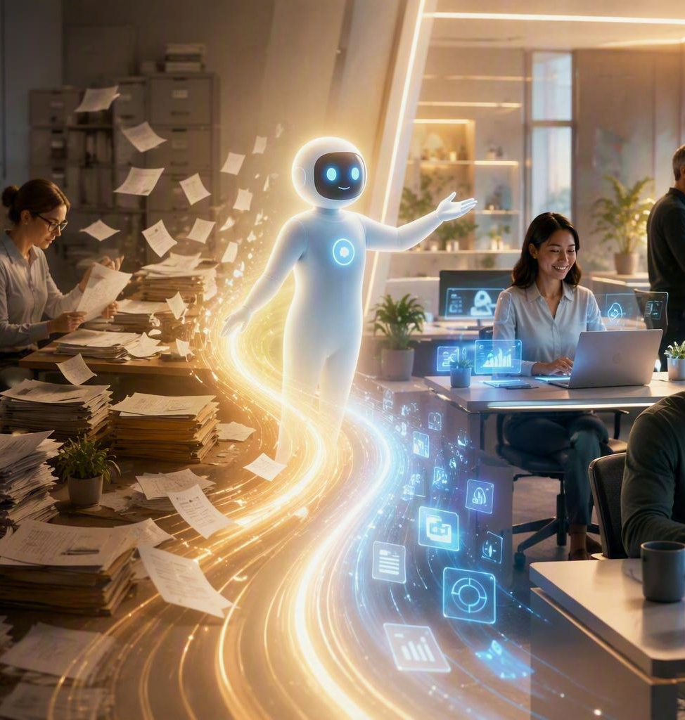
NIRO · Unified Intelligence Platform
Let’s Build the
Future of Work
The NIRO AI Assistant is not just a tool.
It is a trusted work companion that helps teams move faster, work smarter, and make better decisions.
✓
Management ask
Approve a focused prototype to prove value with selected offshore teams.
✨ Smart · Soulful · Scalable
NIRO Pitch • 10/10
Notes:
[Sources]
Visual on this slide was generated with Microsoft Copilot.
Content is based on user-provided NIRO concept and slide outline.

